Slide 1

Improving SAT Participation
Recognizing Patterns
By Luken Weaver, GA 3/27/2020

Slide 2
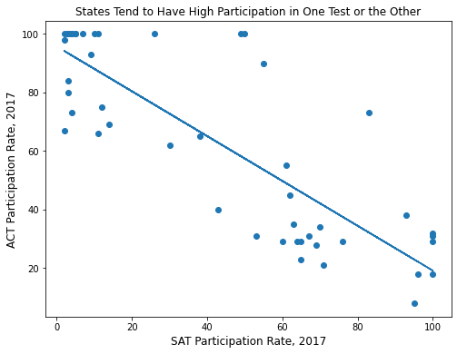
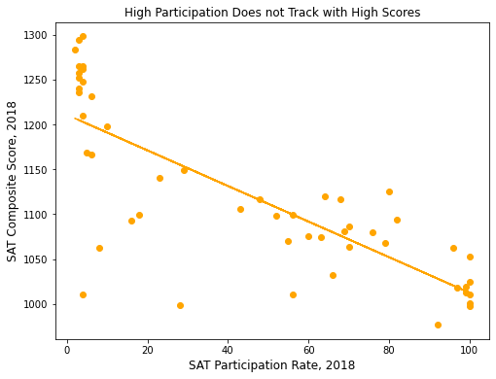
Setting a Baseline
Familiarity is important
Change is hard

Slide 3
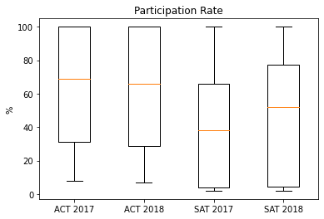
The Situation Right Now
The ACT is the choice of more states, with 12 requiring it
The ACT has better utilization in the states in which it has foothold. Though 12 states require it be taken, 17 states have 100% participation rates in the ACT
The SAT is required in 8 states, and offered in some capacity by the College Board in 20.
Only 5 states had 100% participation
However, some progress has been made.

Slide 4
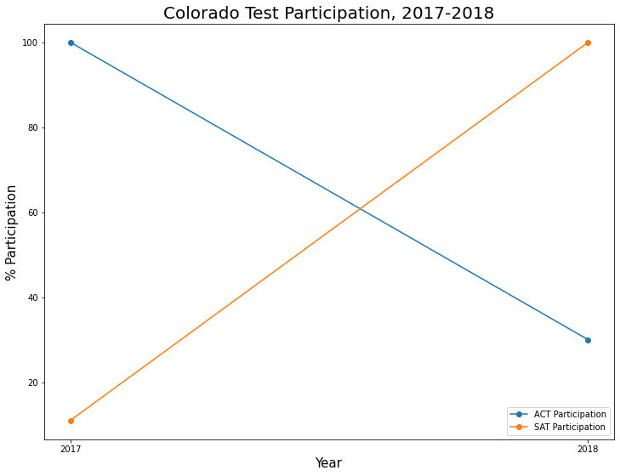
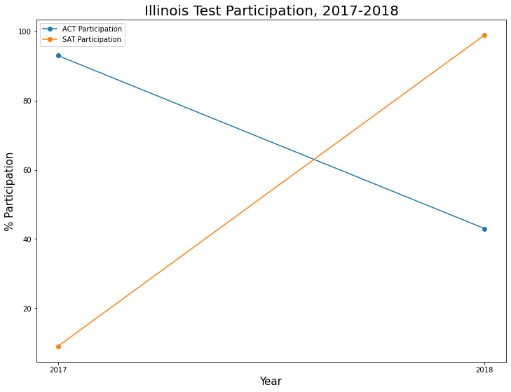
Victories
Between 2017 and 2018, Colorado and Illinois went from almost exclusively using the ACT to the reverse, rising to 100 and 90 percent use of the SAT

Slide 5


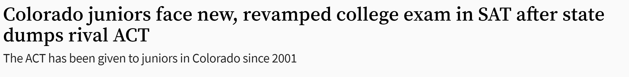

Big Fish
States have limited resources, and a need to assess their education system. By revamping the SAT in 2016 to be more in line with Common Core standards, the College Board was able to win state contracts away from the ACT as a valid test of knowledge, and not just assessment

Slide 6
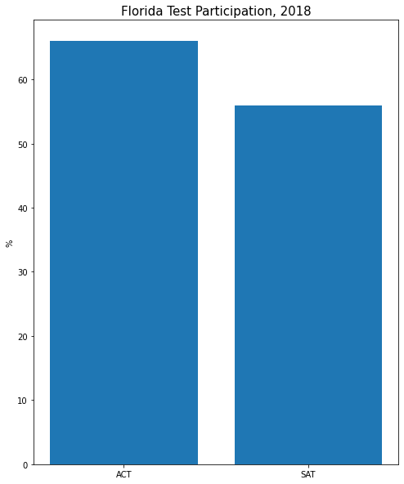

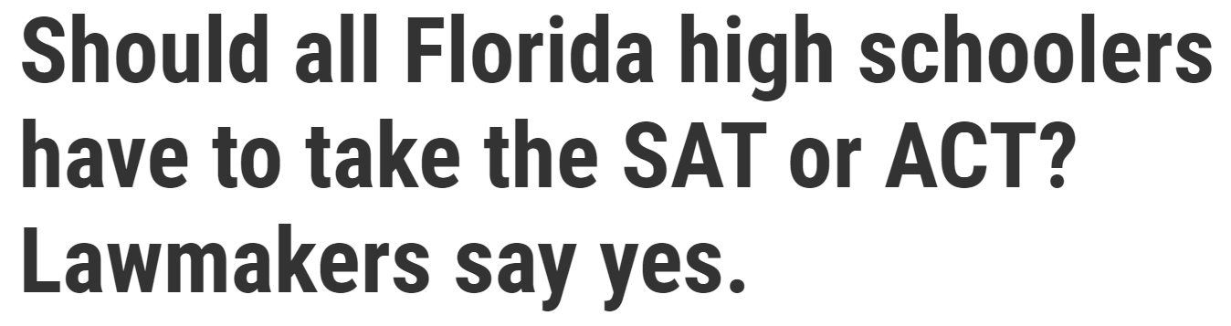
Another Possibility: Battleground States
Some states are moving toward mandatory testing, but have no entrenched “go to” yet.
A state like Florida, which ranked 39th in ACT but 24th in SAT in 2018, might look favorably on wider adoption with the right push

Slide 7

Possible Pathways
This Photo by Unknown Author is licensed under CC BY-ND
Optimize participation in states where the SAT is dominant: appeal to student, state, and college motivations to get 100%
Iterate on big victories; leverage alignment with Common Core to appeal to state bodies
Target either/or’s: tailor your marketing to win over states where participation rates are competitive
Cement existing state relationships to avoid depreciation

Slide 8
Links
https://blog.prepscholar.com/which-states-require-the-sat
https://www.tampabay.com/florida-politics/buzz/2020/02/04/should-all-florida-high-schoolers-have-to-take-the-sat-or-act-lawmakers-say-yes/
https://www.denverpost.com/2017/03/06/colorado-juniors-sat-college-exam/
https://www.chicagotribune.com/news/ct-illinois-chooses-sat-met-20160211-story.html

Slide 9
